Slide 1

Business Intelligence Application
Course Tutor: Eng. Islam Al Omari
Presented by: Marwan Al Farah

Slide 2

Business Intelligence
BI stands for Business Intelligence. It is all about the technology, applications, strategies, and practices that businesses use to collect, combine, analyze and display raw data meaningfully in order to reach data-driven actionable insights. These insights help businesses to make better business decisions: which in turn can lead to drastic improvements of their strategies in different aspects including operational efficiency and customer satisfaction or even financial prosperity.
(IBM, 2016; CallMiner, 2019; Tableau, 2024)

Slide 3
BI Tools and Techniques
Data Visualization: It utilizes tools such as Power BI, Qlik, Tableau, and many other to create visually appealing charts, graphs, and plots, that help stakeholders and users see the data in a visually appealing way and understand it, therefore, helping them understand difficult concepts and identify new patters in order to aid them in decision-making.
Data Warehousing: It is the concept of storing all of an organization’s data (historical and current) in one place that is easily accessible to help with easier comparison and analysis of the data overtime, which enables trend analysis and forecasting. Amazon Redshift, Oracle Database, and Microsoft SQL Server are some examples.
(Anandarajan, Anandarajan and Srinivasan, 2004; CallMiner, 2019; Misiuro, 2022; Indeed Editorial Team, 2024)

Slide 4
BI Tools and Techniques
Data Mining: It is the process of examining data to extract hidden patterns, trends or correlations between variables, which can be used to inform data-driven decision-making and helps solve business challenges. Clustering, classification, regression, and association rules are some of the techniques employed.
Reporting: They are essential for the operational and tactical or even sometimes at the strategic level decision making as they help in generating reports that highlight trends, patterns, and anomalies, and they are regularly or periodically reviewed by stakeholders. Tools Used include SAP Crystal Reports, IBM Cognos.
(Anandarajan, Anandarajan and Srinivasan, 2004; CallMiner, 2019; Misiuro, 2022; Indeed Editorial Team, 2024)

Slide 5
BI Tools and Techniques
Online Analytical Processing (OLAP): OLAP enable users to study data from multiple DBMS at the same time by presenting information from diverse viewpoints, a thing that is especially useful for sophisticated computations, trend analysis, and data modeling. Two of the main tools are: Apache Kylin and Microsoft Analysis Services.
Predictive Analytics: This involves using statistical algorithms and machine learning techniques to forecast future occurrences given past data. Examples of such algorithms include neural networks, decision trees, and various machine learning models.
(Anandarajan, Anandarajan and Srinivasan, 2004; CallMiner, 2019; Misiuro, 2022; Indeed Editorial Team, 2024)

Slide 6
BI Tools and Techniques (Application)
Data Visualization
Maps are used to show the geographic distribution of firms, while other charts, such bar graphs, pie charts, and scatter plots, are used to show other data points and features of the data. With the use of these representations, decision-makers have a clear image of the data, which makes it much simpler to identify any trends or outliers.
Reporting
Reports created through Power BI deliver insights on performance indicators like job application numbers, views and followers of the company. The structure of these reports have been customized to address specific elements that are often sought after to answer particular business questions or to solve some business problem. The reports are also user-friendly leading to a shorter period for the system training and higher involvement levels with the user.

Slide 7
BI Tools and Techniques (Application)
Geographic Visualization: Showing the number of companies by country and state helps in assessing market saturation and potential areas for expansion.
Trend Analysis: The line graphs depicting the growth in data entries over days provide insights into peak activity times and can help in planning resource allocation for data processing.
Correlation Analysis: With the use of scatter plots that display the number of followers and employees in companies we can see any hidden correlations between both variables that might display how workforce might affect social engagement with the company.
Segmentation Analysis: It allows for targeted marketing to each segment, for example by breaking down the job postings by type or by segmenting the companies by sizes.
Statistical Distribution: The histograms show the number of views and applications for each job posting, which help decision-makers understand the user engagement levels and their distribution.

Slide 8

Meeting User or Business Requirements
The BI system is primarily used by department heads, hiring managers, and marketing teams. It has been customized and tailored in various ways to meet the needs of LinkedIn decision-makers who need data-driven decision-making to maximize the company’s market presence and improve their talent acquisition strategies.

Slide 9
Meeting User or Business Requirements
Rapid Data Processing
It is one of the most important requirements for LinkedIn decision makers because the majority of their decisions are based on data, therefore they need quick ways to draw insights from their data. As a result, the system makes it possible to quickly process huge datasets and deliver insights on employee metrics, job postings, etc. on the go.
User centric design
The system is created for non-technical personnel with the expectation of variable levels of technical skills, therefore, the system’s interface was made with the focus on the user experience by making it as intuitive as possible, which will result in higher levels of user engagement with the system and shorter training times.

Slide 10
Meeting User or Business Requirements
Comprehensive Analytics
The system offers a wide range of analytical capabilities, from basic data visualization to more intricate and dynamic data representations. This versatility supports diverse analytical needs across departments, aiding in the decision-making process.
Data Integration
Through the integration of data from numerous LinkedIn sources, such as job postings, user interactions, and company pages, the BI system facilitates the user’s comprehensive understanding of the business environment and accelerates departmental coordination.

Slide 11
Integrated Customizations into the Designs
Custom Reports
The BI system has a customizable Reports that allow users to change the metrics displayed on their it based on what is most relevant to their role. This promotes a personalized user experience where important data visuals are easily accessible by the user.
Interactive Visualizations
Users of the system are able to dive into the metrics for more insightful details using interactive data visualizations. This approach is very beneficial for uncovering hidden patterns within the data, which fosters an enhanced analysis.
Data Filtering Options
In addition, custom filters were added so that users can tweak data according to certain details like time periods or geographical areas or company size. This kind of customization helps in directing the analysis towards particular business questions.

Slide 12
Integrated Customizations into the Designs
Automated Reporting
The system includes an automated reporting feature that can generate regular reports. This automation is done by simply uploading the dataset, which saves time for users, facilitating ongoing monitoring of business metrics.
Page Navigation
It facilitates easy navigation between different pages, each dedicated to specific business areas, therefore, it streamlines the user experience and enhances accessibility to various data insights.
Data Export and Sharing
It provides functionality to export data reports in various formats and share insights directly via email or integrated platforms, therefore, it enhances collaboration across teams.

Slide 13

Integrated Customizations into the Designs
The BI system consists of eight pages, each customized to meet specific needs of the organization and LinkedIn’s decision-makers.
Additionally, it is made with customizations to improve user engagement and guarantee that the information displayed is relevant and actionable.
This approach helps LinkedIn make a wide variety of strategic decisions, from plans for market development to human resources.

Slide 14
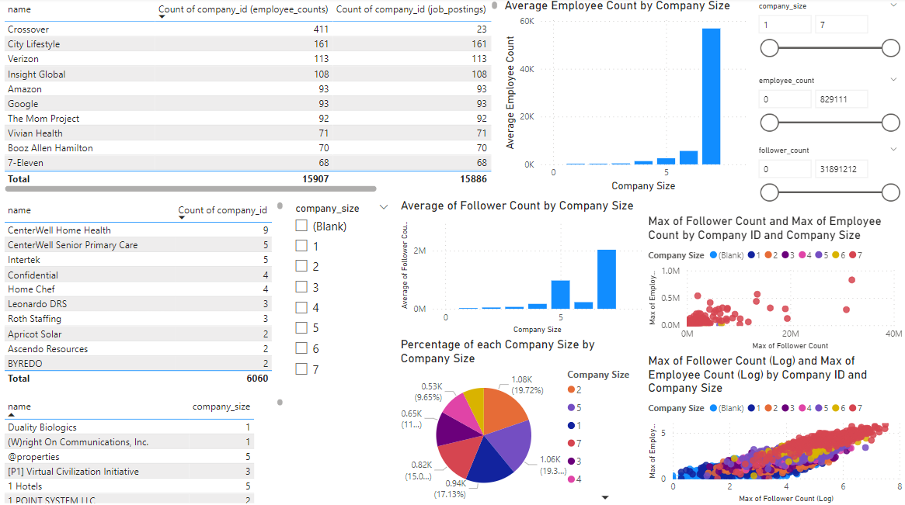
Integrated Customizations into the Designs
Overview of Employee and Company Metrics
Content: The page shows primary indicators (count of employees, number of job postings, follower statistics) in a company with respect to the size, name or ID. It showcases graphical representations (bar charts and pie charts) that shows employee and follower distributions and counts in different company sizes.
Decision Support: Assists the HR and social reach of companies on LinkedIn, by aiding in strategic decisions regarding partnerships and talent acquisition.
Customization: Filters for firm size, and employee and follower counts are included, enabling users to tailor the data to their own interests or strategic priorities.

Slide 15
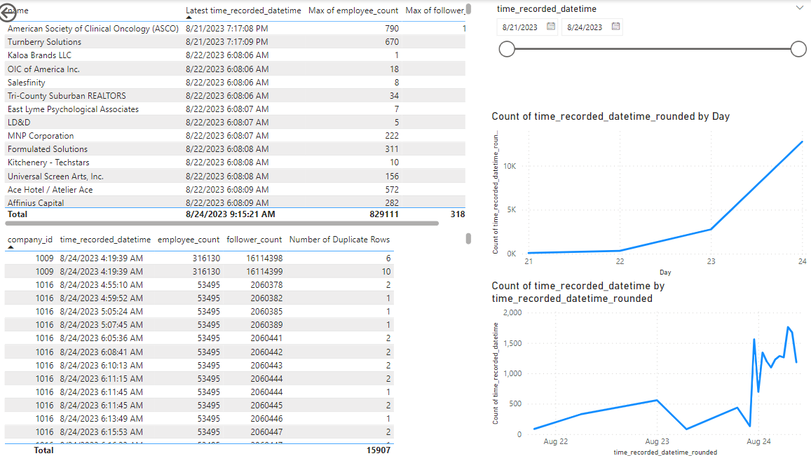
Integrated Customizations into the Designs
Time Series Analysis of Data Collection
Content: Displays the patterns in data gathering over time that include indicators such as the latest time records and employee and follower count.
Decision Support: Tracking the growth or shrinkage of engagement and workforce over specific periods which is essential to trend analysis and forecasting, helping ensure appropriate actions are taken based on these results.
Customization: Users can adjust the time frame to view short-term changes or long-term trends, enhancing the flexibility of temporal analysis.

Slide 16
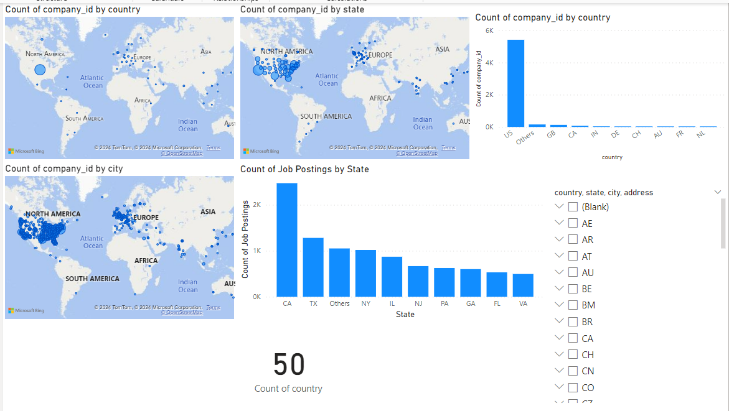
Integrated Customizations into the Designs
Geographic Distribution of Companies
Content: Provides maps and bar charts showing the geographic distribution of companies by country, state, and city.
Decision Support: It can be useful for geographical market analysis, as it helps in pinpointing areas with high numbers of companies, which is very useful for targeted marketing or even recruitment strategies.
Customization: Geographical filters and cascading down from country, to state, to city, then to address levels enables users to concentrate on particular areas and their specific needs.

Slide 17
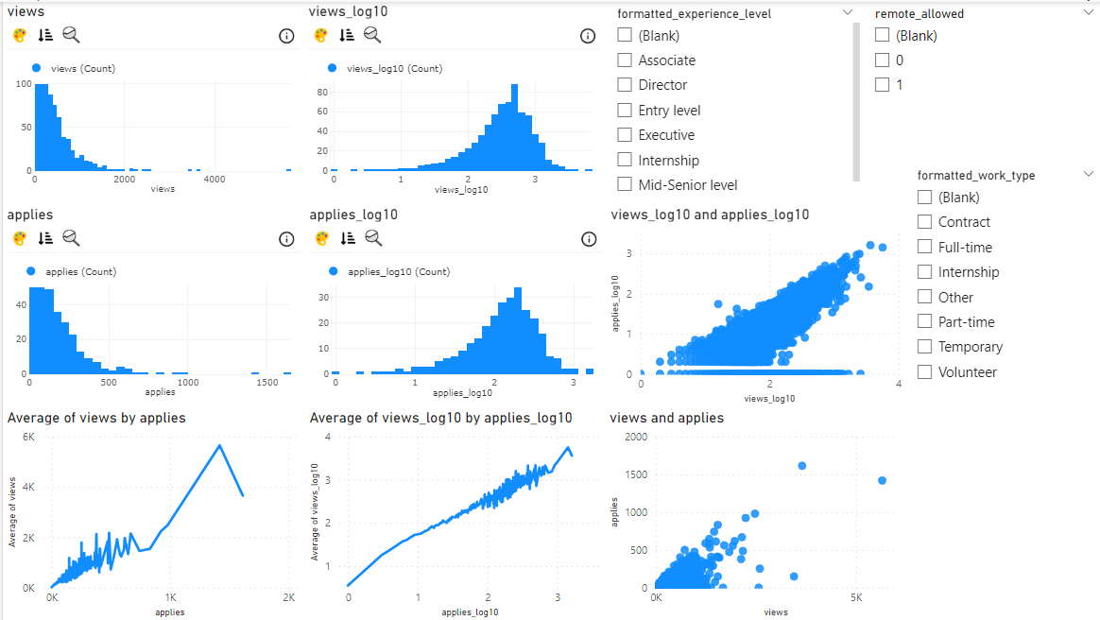
Integrated Customizations into the Designs
Job Application Insights
Content: Detailed analysis of job application metrics, such as views and applications per job posting, by correlating the number of views with the number of applications using histograms and scatter plots.
Decision Support: This helps in understanding how popular a job is and how effective job listings are, helping to optimize where jobs are advertised.
Customization: Includes logarithmic scales and the ability to toggle between linear and log views to suit different analytical needs. Users can filter data based on job type, experience level, and whether remote work is allowed or not, by pinpointing specific jobs that correlate to the user’s needs.

Slide 18
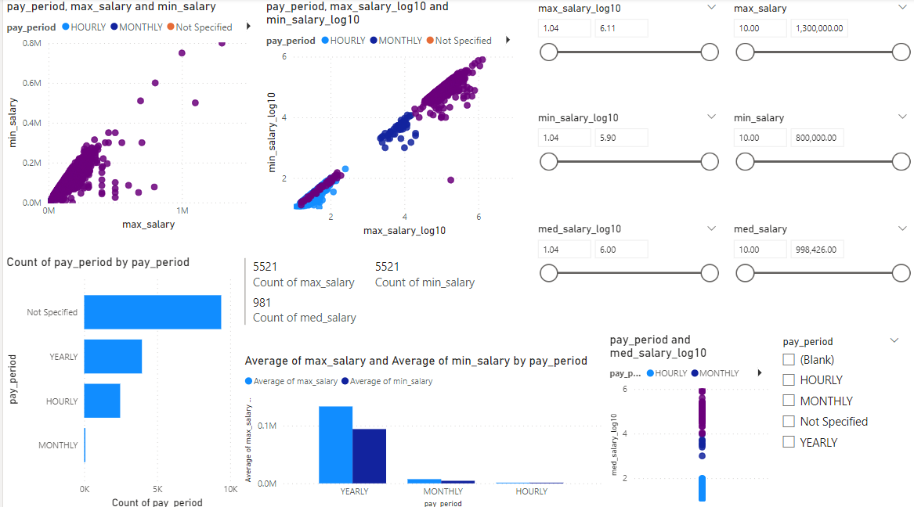
Integrated Customizations into the Designs
Detailed Compensation Analysis
Content: Examines pay data at several time intervals (hourly, monthly, yearly) to illustrate the distribution of the highest, lowest, and median earnings.
Decision Support: By determining what its competitors are paying and whether they are adhering to industry norms or not, this service helps firms to make well-informed decisions about their pay structures.
Customization: Users can filter data to get relevant salary insights and pay periods.

Slide 19
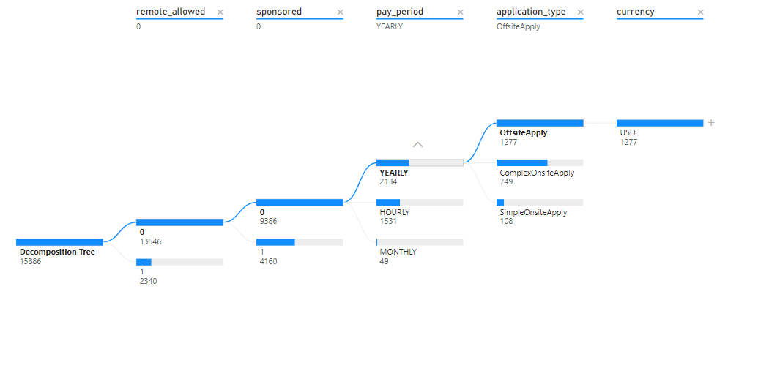
Integrated Customizations into the Designs
Decomposition Analysis for Job Posting Metrics
Content: In the exploration of factors influencing job posting metrics, such as application types, experience levels, and compensation types, this page uses decomposition trees.
Decision Support: It helps in determining the key drivers of job posting performance, which can play a significant role in fine-tuning strategies for job advertisement.
Customization: Through an interactive decomposition feature that permits users to choose specific metrics and factors for study, the tool becomes highly adaptable and thus more user-friendly.

Slide 20
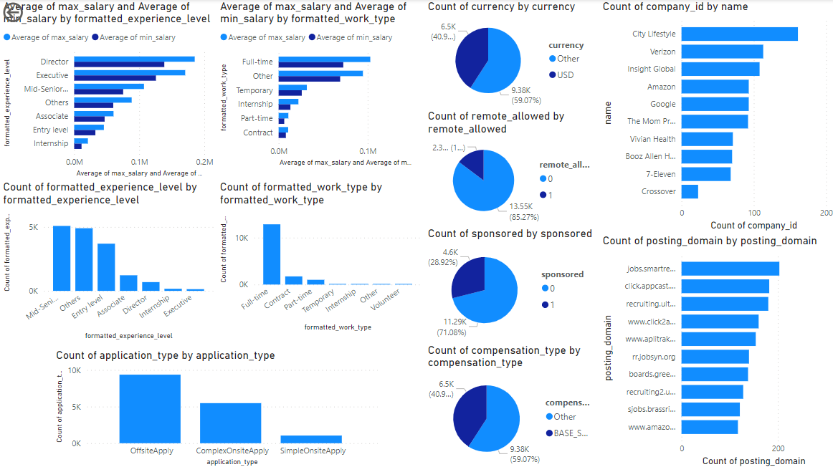
Integrated Customizations into the Designs
Job Postings
Content: Mainly focusing on the job postings insights such as sponsorship status, currency, remote work allowances, and compensation type which is visualized in pie charts and bar graphs.
Decision Support: Such information helps HR and strategy teams make more informed decisions when tailoring job postings to candidate preferences for remote work availability as well as realizing impact that sponsorship has on applicant pools.
Customization: Filters can be used to separate data into different segments based on whether they are eligible for remote work or sponsorship status thus customizing analysis according to prevailing market dynamic skills and job title analysis.

Slide 21
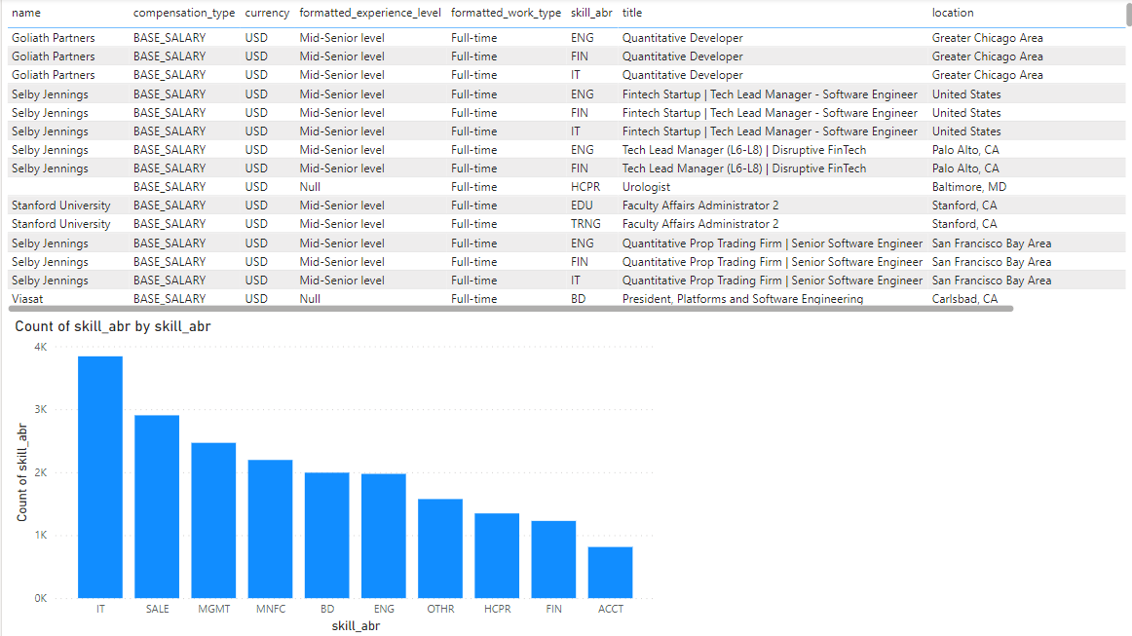
Integrated Customizations into the Designs
Skills and Job Title Analysis
Content: It delves into the assessment of skill demands and job titles. It entails information that shows how often certain skills are needed and the nature of positions available.
Decision Support: It plays a role in aiding individuals to recognize what skills are needed most and therefore adjust training programs to suit them. It also assists in customizing recruitment teams to focus their recruitment towards employees within specific career paths.
Customization: It is achieved through two primary filters, skills and titles, which enable a more focused approach for labor market prerequisites.

Slide 22
Some Insights
There is a high positive relationship that exists between the count of views and applications. This means improving visibility will help increase application rates. Some of the strategies that could be adopted to improve visibility include SEO investments, development of detailed job descriptions, and enhancing the platform’s visibility which would then lead to more applications.
It shows that the highest average salaries are drawn by Directors and Executives. On the flip side, Entry-level and Internship positions give much lower salaries. Knowing this can be very useful, as it can help in setting salary benchmarks to attract top talent for high-level roles with competitive offers, but at the same time ensuring budget efficiency for entry-level positions.
Full-time positions have, on average, much higher salaries than part-time, contract and internship positions; hence, it is very important for organizations to clearly define the roles of their employees while aligning the salary expectations that would see them attract the best fit candidates for full-time roles.

Slide 23
Some Insights
The majority of job postings (71.08%) do not have sponsors, indicating that organic reach is still effective. To maintain visibility without depending heavily on paid promotions, it is advisable to concentrate on improving company profiles, employee advocacy, and creating engaging content.
The high density of job advertisements in the United States especially in California reveals areas with significant hiring rates. This data can help organizations to strategically focus on these regions for their recruitment drives, collaborations and even local market entry strategies.
The top skills in demand are IT, Sales, and Management. In order to satisfy market needs and foster growth of the business, companies must establish a talent acquisition strategy as well as training programs for these high-demand skills.

Slide 24
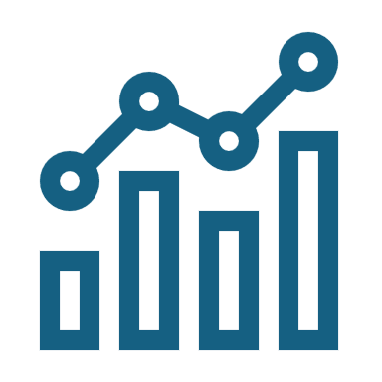
BI and Effective Decision-Making

Slide 25

BI and Effective Decision-Making
BI tools play a crucial role in improving decision-making processes in companies. They offer very important functionalities that help organizations to collect, store and process (through analysis and visualization) large amounts of data which they can use to make informed decisions on strategies as well as streamline their business operations.

Slide 26
BI and Effective Decision-Making
Data Aggregation and Integration: BI tools facilitate the consolidation of data from various origins such as internal databases and social media feeds and external datasets. This integration provides decision-makers with a comprehensive perspective of their business environment, ensuring that decisions are made based on a holistic understanding of organizational data.
Advanced Analytics: BI tools facilitate the discovery of patterns and trends in data using advanced analytical methods. This includes predictive analytics, machine learning, and statistical analysis. These findings make it possible for organizations to come up with future forecasts about future outcome and trend, such as market movements or customer behavior, allowing them to act proactively.
Real-time Access and Reporting: BI tools offer the ability to view data and make decisions based on real-time data, an important factor in any rapidly changing business environment. Real-time reporting allows for immediate action to be taken on any issues or opportunities that arise, helping decision makers adopt a more proactive stance rather than reacting after the fact.
(Wieder and Ossimitz, 2015; Kyligence, 2022; FineBI, 2023; Phocas Software, 2023; Qlik, 2023; Eric, 2024)

Slide 27
BI and Effective Decision-Making
Enhanced Data Visualization: Visualization features of BI tools, make complex data more accessible and understandable. By presenting data in a visually engaging format, these tools help communicate insights across different levels of the organization, ensuring that all stakeholders can participate in the decision-making process informedly.
Improved Accuracy and Efficiency: Automation capabilities embedded in BI solutions lower the likelihood of human error, which, in turn, enhances operational efficiency for data management processes. When automation takes over routine tasks, it liberates manpower from less important things to concentrate on high-level strategic endeavors that demand cognitive acumen, therefore, not only expedites decision-making but also ensures its richness with quality.
Strategic Alignment and Performance Monitoring: BI tools help in tracking the KPIs and metrics, which in turn assist companies in strategic alignment of their vision with day-to-day activities ensuring all decisions made are supportive to the overall organization's objectives while the performance is regularly monitored and optimized.
(Wieder and Ossimitz, 2015; Kyligence, 2022; FineBI, 2023; Phocas Software, 2023; Qlik, 2023; Eric, 2024)

Slide 28
Case Studies: Enhancement of Operations Through BI Tools
Notes:
In the modern business environment, leveraging Business Intelligence (BI) tools has become crucial for enhancing operational efficiencies and competitive advantage. This section presents several case studies of organizations that have successfully utilized BI tools to improve their operations, showcasing the diverse applications and tangible benefits of BI technologies.

Slide 29

Amazon
The retail giant Amazon has used BI tools to significantly change its inventory management systems.
By analyzing data from various sources, such as historical sales and seasonal demand trends as well as lead times of suppliers, Amazon's BI systems are able to forecast demand with precision.
Because of this ability, they ensure having just the right amount of stocks at all times, which helps in cutting down on storage costs while keeping the risk for stockouts minimal.
Consequently, Amazon has kept its high customer satisfaction rates up by always delivering on time.
(Amazon, 2023; Anthony, 2023)

Slide 30

FedEx
FedEx uses Business Intelligence tools in such a way that it can help decide the optimal routes for deliveries and time schedules are decided by real-time traffic data, weather information and details available from package tracking systems.
These improvements have helped them cut down a lot on delivery times as well as what they would have otherwise spent operationally.
In addition to that, customers benefit from enhanced route efficiency and ensured timely deliveries that leads to enhanced customer service. Ensuring timely deliveries is a very important element that all logistics companies need to be concerned with.
(Roundtrip.ai, 2022; Hillary, 2023; Toodlify.ai, 2024)

Slide 31

Coca-Cola
Coca-Cola uses BI tools to oversee and analyze the social media and consumer complaints, sales data as well.
They do this so as to understand market dynamics, which are heavily influenced by the consumers' preferences that in return can be a feedback of the sales.
This detailed analysis greatly helps Coca-Cola in their marketing strategies; by customizing their advertisements and releasing new products based on specific demographic likes.
In turn, Coca-Cola has greatly been able to improve its market share (penetration into new markets) and customer loyalty.
(van Rijmenam, 2013; The Coca-Cola Company, 2021; Teselko, 2022; Panigrahi, 2023)

Slide 32

Legal Considerations in the Utilization of BI Tools

Slide 33
Data Privacy and Protection
Among the top legal worries surrounding BI tool utilization is the observance of data privacy legislations.
The General Data Protection Regulation (GDPR) in the European Union and California Consumer Privacy Act (CCPA) in United States are regulations that have placed strict instructions about how personal data should be handled including its collection, storage, and processing.
There is a need for organizations to make sure that their BI practices follow to these regulations by putting in place strong data governance frameworks, by including consent management, data minimization, and rights to data access and erasure.
Take Amazon as an example, in its BI for inventory control, it has to meet the requirements of GDPR and CCPA. It is therefore necessary for Amazon to have robust data governance and consent management for inventory control which would prevent fines and guarantee customer trust as a result of compliance with these regulations.
(Morgan, 2019; APEXCARE MEDIGENIX, 2023; Brush, 2023; Scholar, 2023; Business Intelligence Consulting, 2024)

Slide 34
Intellectual Property Rights
BI tools often involve the use of proprietary algorithms and software, as well as the generation of new intellectual property through data analysis and visualization.
Organizations need to ensure proper licensing for both software and data used, in addition to securing their innovations via patents or copyright.
Ignorance of IP rights can lead to expensive lawsuits, in addition to public image issues with the company.
Take FedEx as an example, they use their own algorithms for delivery route optimization; Coca-Cola also relies on proprietary algorithms for social media analysis. These practices demand appropriate licensing and intellectual property protection to avoid litigation costs that would be damaging not only financially but also in terms of reputation.
(Morgan, 2019; APEXCARE MEDIGENIX, 2023; Brush, 2023; Scholar, 2023; Business Intelligence Consulting, 2024)

Slide 35
Compliance with Industry Standards
Different sectors are governed by different regulatory standards which require the proper handling of data.
For example, the United States' Health Insurance Portability and Accountability Act (HIPAA) mandates that the healthcare industry adhere to laws requiring the safe transfer and storage of Protected Health Information (PHI).
The financial sector is bound by standards like the Payment Card Industry Data Security Standard (PCI DSS), as companies must ensure that their BI tools and techniques meet these regulations to avoid fines and data breaches.
Consider how Amazon needs its BI tools to fall in line with PCI DSS; think of FedEx ensuring compliance with logistics regulations, or Coca-Cola aligning their BI tools with marketing standards. It's done not only to prevent penalties but also to uphold data integrity.
(Morgan, 2019; APEXCARE MEDIGENIX, 2023; Brush, 2023; Scholar, 2023; Business Intelligence Consulting, 2024)

Slide 36
Cross-Border Data Transfer
BI tools usually require data to be moved across borders, so organizations need to be very careful to ensure they comply with international laws governing the transfer of data.
This is especially important for companies that work in more than one country or those who use cloud services based in different places around the world.
Regulations like the GDPR put down tight conditions about moving data out of a country; this includes having certain mechanisms (such as standard contractual clauses or corporate binding rules) that need to be present if such transfers are taking place.
Amazon, FedEx, and Coca-Cola are some of the companies that have to deal with General Data Protection Regulation (GDPR) when transferring data across borders. They have to find ways of meeting international data laws which might involve implementing standard contractual clauses as a way of compliance with the laws.
(Morgan, 2019; APEXCARE MEDIGENIX, 2023; Brush, 2023; Scholar, 2023; Business Intelligence Consulting, 2024)

Slide 37
Cybersecurity Measures
BI tools usage leads to high exposure to cyber risks such as unauthorized access or data leakage through cyber-attacks.
It is necessary that organizations make sure they have strong cybersecurity measures in place to protect their data assets, which should include encryption methods and access controls, with regular security audits.
A failure to protect data sufficiently might have repercussions, and these could be fines plus legal actions.
Amazon uses encryption and access controls; FedEx does regular security audits; Coca-Cola deploys robust cybersecurity protocols: all for the sake of data protection and ensuring no fines or legal actions follow suit.
(Morgan, 2019; APEXCARE MEDIGENIX, 2023; Brush, 2023; Scholar, 2023; Business Intelligence Consulting, 2024)

Slide 38

Using BI to Extend Target Audience and Gain a Competitive Edge

Slide 39
Enhanced Market Segmentation and Targeting
BI tools give organizations the ability to carry out intricate data analysis to help in uncovering different customer segments based on various demographics, as well as their purchasing behavior details.
It leads to segmented promotions, thus making marketing more interesting and targeted as these two go hand in hand.
In order to reach a wider and more varied customer base, companies need to start customizing their products and advertising information by recognizing the particular demands of various segments.
An illustration is how Amazon utilizes BI, they analyze huge customer data to be able to generate precise target segmentation that makes it possible for them to conduct highly individualized marketing campaigns.
While doing so, companies should ensure compliance with security legislation such as GDPR and CCPA by customer data encryption and applying access controls which play a key role in maintaining customer trust and, at the same time, keeping data secure.
(Jonas, 2017; FasterCapital, 2021; Phocas Software, 2022; Stitch, 2022; Kelly, 2023; Dunlea, 2024; Rizwan, 2024)

Slide 40
Predictive Analytics for Consumer Behavior
Through predictive analytics, businesses are able to predict future consumer trends and behaviors.
This proactive method enables organizations to be aware of market trends before they are even made, allowing them to make adjustments in their strategies without any reluctance.
As an illustration, Amazon's BI systems forecast seasonal fluctuations in what consumers favor. This helps the company fill its inventory with products that are likely to appeal to customers and therefore make it easier to meet customer expectations on a consistent basis.
In much the same way, FedEx uses predictive analytics to forecast delivery needs based on upcoming demand so as to streamline their route planning process.
To maintain the confidentiality of customer data according to laws on data protection, both Amazon and FedEx adopt strict measures in data anonymization and secure data processing during the predictive analytics process, while ensuring compliance and at the same time enhancing their market reach.
(Jonas, 2017; FasterCapital, 2021; Phocas Software, 2022; Stitch, 2022; Kelly, 2023; Dunlea, 2024; Rizwan, 2024)

Slide 41
Product and Service Innovation
BI tools offer valuable insights that drive creativity to evolve products and services.
When companies take customer feedback plus market trend analysis, they are able to detect where the market is failing to meet their needs, which creates a new area for development of products or improvement of what already exists.
These innovations, courtesy of BI, not only reach a larger audience but make the organization take up a leading position in the industry, as it further solidifies their competitive advantage.
Coca-Cola uses BI to keep an eye on how its customers feel about the product through social media posts and complaints. This helps them to know what they need to change or improve and what should be their next step as a business entity. These innovative ideas allow Coca-Cola to reach a broader audience and establish themselves as a leader in the market.
The company has some legal obligations to protect sensitive customer information that they use during these innovation processes, which is why Coca-Cola implements strong encryption methods together with secure storage systems for the data.
(Jonas, 2017; FasterCapital, 2021; Phocas Software, 2022; Stitch, 2022; Kelly, 2023; Dunlea, 2024; Rizwan, 2024)

Slide 42
Enhancing Customer Experience
A direct application of BI is in enhancing the customer experience through personalized interactions.
Personalized support is thus more likely to result in customer satisfaction and loyalty as well as attracting new clients looking for a unique shopping experience. This involves using information obtained from data on how customers prefer being treated.
For instance, customers who like being called by their first name can be addressed that way during shopping while others may have specific products recommended based on their preferences.
Amazon excels In this domain, as it uses BI for the purpose of suggesting products that customers may be interested in based on their previous purchases plus what they have been viewing. FedEx makes use of BI to inform its customers of live tracking reports and notifications about the deliveries made, thereby enhancing service dependability.
For purposes of security legislation both companies employ strong encryption mechanisms which include robust protocols and frequent audits while at the same time maintaining data privacy.
(Jonas, 2017; FasterCapital, 2021; Phocas Software, 2022; Stitch, 2022; Kelly, 2023; Dunlea, 2024; Rizwan, 2024)

Slide 43
Compliance with Security Legislation
While extending the target audience and enhancing competitive capabilities, organizations must consider the security legislation relevant to BI data handling.
This includes ensuring data privacy, securing data transfers, and maintaining transparency in data usage.
Compliance not only shields the organization from legal action but also builds trust with customers, which can be a significant competitive advantage in environments reliant on data sensitivity.
Amazon, FedEx and Coca-Cola are each following very strict data protection regulations based on their own industries. For instance, GDPR, CCPA and HIPAA.
They ensure their BI projects are both legally compliant and successful by implementing complete data security measures which has a double effect of being legally compliant and sustaining their market leadership.
(Jonas, 2017; FasterCapital, 2021; Phocas Software, 2022; Stitch, 2022; Kelly, 2023; Dunlea, 2024; Rizwan, 2024)

Slide 44
References
Amazon (2023) AI-Powered Inventory Management, Amazon.
Anandarajan, M., Anandarajan, A. and Srinivasan, C.A. (2004) ‘Business Intelligence Techniques’, Business Intelligence Techniques [Preprint].
Anthony (2023) Amazon’s Business Intelligence Tools: Advanced Techniques for Analyzing and Visualizing Data - Signalytics, Signalytics.
APEXCARE MEDIGENIX (2023) 8 Legal Issues for Business Intelligence Tools: Expert Insight, APEXCARE MEDIGENIX.
Brush, J. (2023) Legal Issues in Business Intelligence Tools: Compliance and Governance, Jade Brush.
Business Intelligence Consulting (2024) What Key Considerations Should Businesses Keep in Mind for Legal Compliance with BI?, Business Intelligence Consulting.
CallMiner (2019) What is Business Intelligence? Definition & Tools, CallMiner.
Dunlea, J. (2024) Business Intelligence in Marketing: Unlocking Growth and Efficiency At Scale, Akkio.
Eric, J. (2024) How Business Intelligence Helps in Decision-Making: Complete Guide, Data Rundown.
FasterCapital (2021) The Importance Of Business Intelligence In Gaining A Competitive Edge -, FasterCapital.

Slide 45
References
FineBI (2023) Enterprise Business Intelligence: A Comprehensive Guide, FineBI.
Hillary (2023) How FedEx is Revolutionizing Package Tracking with AI and Machine Learning - TechBullion, TechBullion.
IBM (2016) What Is Business Intelligence (BI)?, IBM.
Indeed Editorial Team (2024) What Is Business Intelligence? (With Techniques And Uses), Indeed.
Jonas (2017) 10 Ways Business Intelligence Can Improve Your Business, Jonas.
Kelly, I. (2023) Unlocking the Potential of Data: Harnessing Business Intelligence for a Competitive Edge, Lightningpoint Global.
Kyligence (2022) How Business Intelligence Helps in Decision Making?, Kyligence.
Misiuro, A. (2022) What are the Business Intelligence Techniques: a quick overview, Synder.
Morgan, J. (2019) Managing Data Security for Business Intelligence Tools, OpenMind.
Panigrahi, S. (2023) Coca-Cola’s Social Media Strategy: A Deep Dive Into A Gripping Strategy, Keyhole.
Phocas Software (2022) How to use BI to gain competitive advantage in business, Phocas Software.
Phocas Software (2023) How do businesses make decisions with BI?, Phocas Software.
Qlik (2023) What is Business Intelligence? A Complete Guide, Qlik.

Slide 46
References
van Rijmenam, M. (2013) How Coca-Cola takes a refreshing approach on big data, Datafloq.
Rizwan (2024) The competitive edge: How Business Intelligence (BI) gives businesses a strategic advantage in today’s market, IAXservices.
Roundtrip.ai (2022) The Smart Strategy: How FedEx Plans Their Routes, Roundtrip.ai.
Scholar, A. (2023) 8 Common Legal Issues Businesses Face with Business Intelligence Tools, Insight Tribune.
Stitch (2022) Using business intelligence tools for marketing, Stitch.
Tableau (2024) Business intelligence: A complete overview | Tableau, Tableau.
Teselko, E. (2022) How Coca-Cola leverages social media analytics, YouScan.
The Coca-Cola Company (2021) Coca-Cola’s 2021 Marketing Innovation Portfolio Strategy, News.
Toodlify.ai (2024) Transforming Package Delivery: How FedEx’s AI-Powered System Revolutionizes Routes, Toodlify.ai.
Wieder, B. and Ossimitz, M.L. (2015) The Impact of Business Intelligence on the Quality of Decision Making, Procedia Computer Science.

Slide 47

Thank You!

